Slide 1

Resume Ranking System

Slide 2
Why I choose this use case?
I choose it, because it combines two of my core interest; NLP and ML.
Additionally, this project has a potential to have a significant impact on the efficiency and effectiveness of the recruitment process.
Overall, I am excited about the opportunity to work on a project that leverage advanced Technologies to solve real world problems.

Slide 3
References
Dataset used: https://www.kaggle.com/datasets/gauravduttakiit/resume-dataset
Playlist: https://youtube.com/playlist?list=PLKnIA16_RmvZo7fp5kkIth6nRTeQQsjfX&si=6Dydn6bmJfmsAgjp

Slide 4
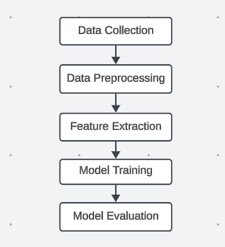
Algorithm Flow

Slide 5
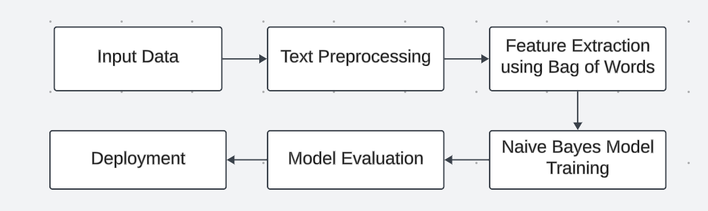
Solution Architecture

Slide 6

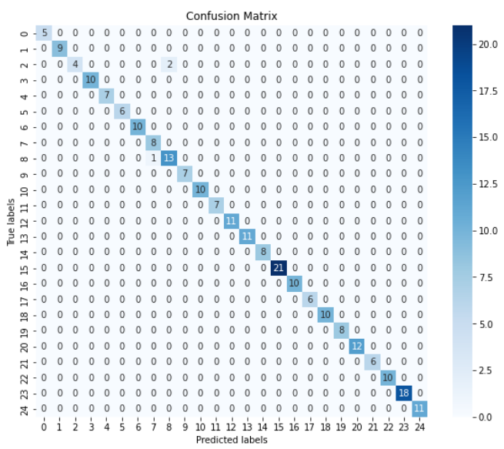
Model Validation
Accuracy Score:
98.77 %
Confusion Matrix

Slide 7
Final Outcome
Final Outcome is a Web Application.
It takes Resume Content and preprocess it.
After Preprocessing, Model Predicts a job role which is most suitable to the providing Input.
This, is a final resume screening web application.

Slide 8
Potential Benefits
Time Saving: Automated resume ranking reduce manual efforts, saving time for recruiters.
Cost Efficiency: Streamline recruitment process can lead to cost saving for organization.
Faster Hiring Process: Automated screening speed up the hiring timeline
Scalability: Solution can scale to handle large volume of resume as the organization grows.

Slide 9
Project Link
GitHub Repository Link
DataSet Link

